Slide 1
Building Kubernetes From Source

Slide 2
Prerequisite
- An ubuntu master server (version 18.04+)
- More than 4.5GB of memory (preferably 8GB+)
- 60GB of free space

Slide 3
Building K8s From Source - 1
- Install docker
sudo apt update
sudo apt install –y docker.io
sudo usermod –aG docker $USER
newgrp docker
sudo systemctl enable docker
- Install compilation and other tools
sudo apt install -y gcc make socat curl git

Slide 4
Building K8s From Source - 2
- Compile and build K8s
git clone https://github.com/kubernetes/kubernetes
cd kubernetes
make quick-release

Slide 5
Building K8s From Source - 2
- Load Binary as Docker Image
cd _output/release-tars
tar –xvf kubernetes-server-linux-amd64.tar.gz
cd kubernetes/server/bin
docker load < kube-controller-manager.tar
docker images

Slide 6
Install Kubernetes

Slide 7
Prerequisite
- An ubuntu slave server (version 18.04+)
- More than 2GB of memory
- 40GB of free space

Slide 8
Install K8s - 1
- Install Docker on both master / slave node(Slide 3)
- Install Kubeadm on both nodes
curl -s https://packages.cloud.google.com/apt/doc/apt-key.gpg | sudo apt-key add
sudo apt-add-repository "deb https://apt.kubernetes.io/ kubernetes-xenial main”
sudo apt install kubeadm

Slide 9
Install K8s - 2
- Disable swap memory on both nodes
sudo swapoff -a
- Set Hostnames for both nodes
(master node) sudo hostnamectl set-hostname master-node
(slave node) sudo hostnamectl set-hostname slave-node

Slide 10
Install K8s - 3
- Initialize Kubernetes on master node as root
kubeadm init --pod-network-cidr=10.244.0.0/16
- Apply config on master node
mkdir -p $HOME/.kube
sudo cp -i /etc/kubernetes/admin.conf $HOME/.kube/config
sudo chown $(id -u):$(id -g) $HOME/.kube/config

Slide 11
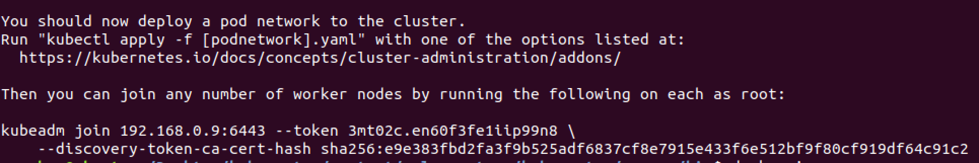
Install K8s - 4
- Join the master node on slave node
Copy and run on slave node

Slide 12
Install K8s - 5
sudo kubectl apply -f https://raw.githubusercontent.com/coreos/flannel/master/Documentation/kube-flannel.yml
kubectl get nodes

Slide 13
Install K8s - 6
- Apply built binary
sudo vim /etc/kubernetes/manifests/kube-controller-manager

Slide 14
Working with Kubernetes

Slide 15
DashBoard (GUI)
Deploy dashboard:
kubectl apply -f https://raw.githubusercontent.com/kubernetes/dashboard/v2.0.0-beta8/aio/deploy/recommended.yaml
kubectl proxy
Enter http://localhost:8001/api/v1/namespaces/kubernetes-dashboard/services/https:kubernetes-dashboard:/proxy/ on a browser to enter the dashboard

Slide 16
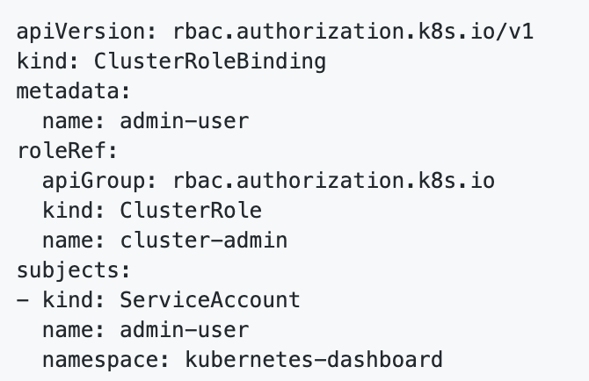
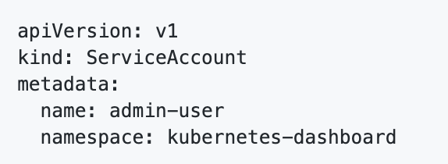
DashBoard (GUI) - Token
admin_user_account.yml
admin_user_role.yml

Slide 17
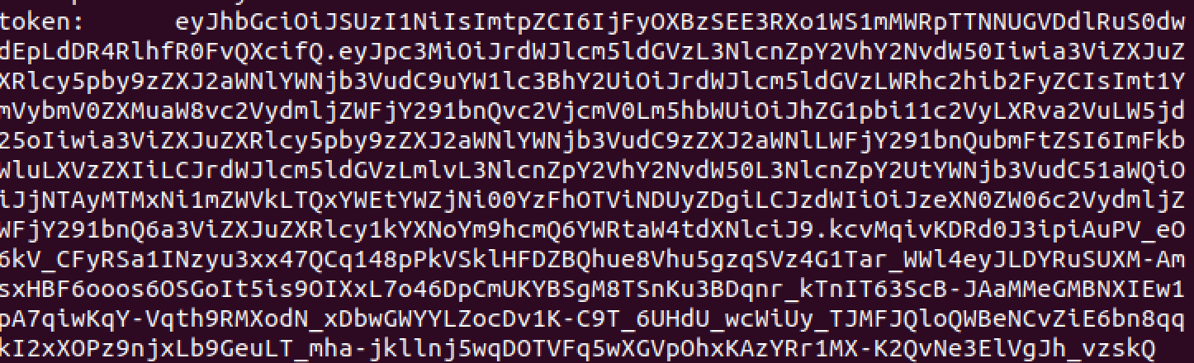
DashBoard (GUI) - Token
kubectl apply –f admin_user_account.yml
kubectl apply –f admin_user_role.yml
kubectl -n kubernetes-dashboard describe secret $(kubectl -n kubernetes-dashboard get secret | grep admin-user | awk '{print $1}')

Slide 18
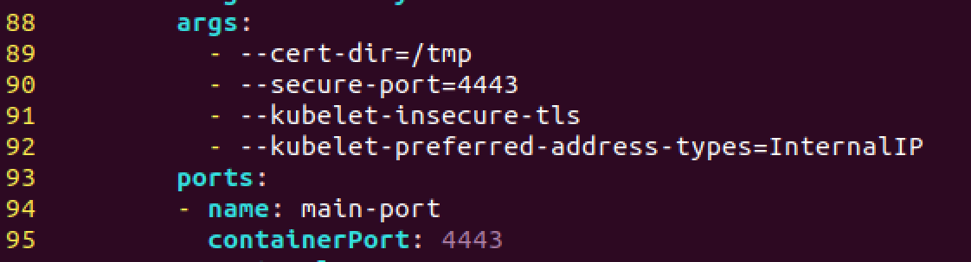
Metric Server
Fetch metric server:
wget https://github.com/kubernetes-sigs/metrics-server/releases/download/v0.3.6/components.yaml
kubectl apply –f components.yaml
Add to components.yaml

